Slide 1
Image-Based Situation Awareness Audit 1.3.2018
Sakari Lampola

Slide 2
Work Done

Slide 3
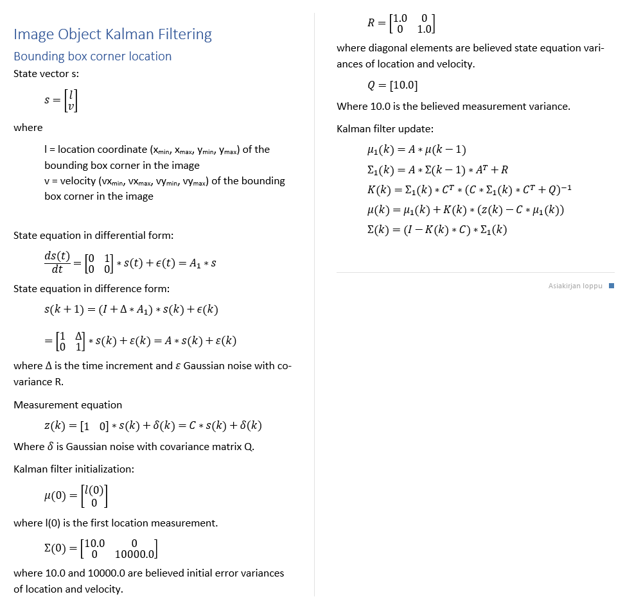
Image object velocity is necessary for:
predicting image object locations when matching new measurements
identifying image objects
predicting image object locations for hidden objects
Image object
id
status
x_min
x_max
y_min
y_max
vx_min
vx_max
vy_min
vy_max
class
confidence
appearance
Image Object Velocity Estimation
Estimation algorithm
Numerical values are estimated using grid search and 10 step ahead
mean prediction error. Values rounded.

Slide 4
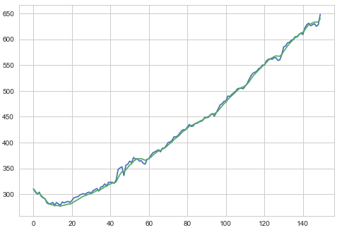
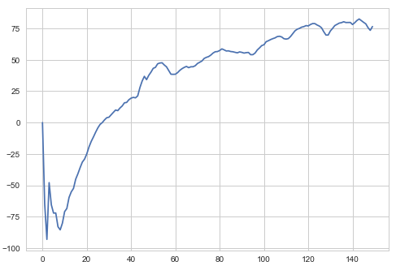
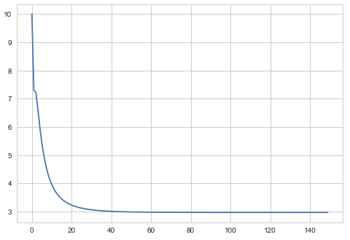
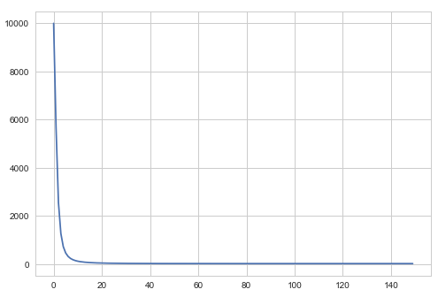
Moving object (car)
Image Object Velocity Estimation
Measured and filtered location (upper left corner)
Estimated velocity
Location variance
Velocity variance

Slide 5
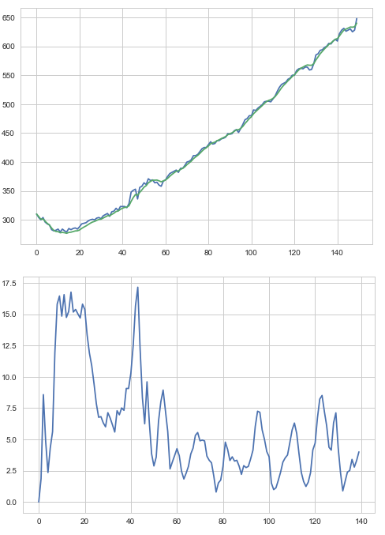
Moving object (car)
Image Object Velocity Estimation
10 step ahead mean prediction error

Slide 6
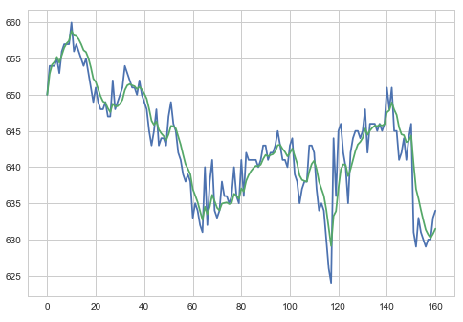
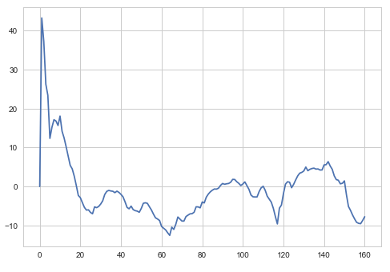
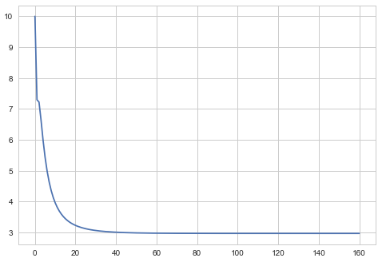
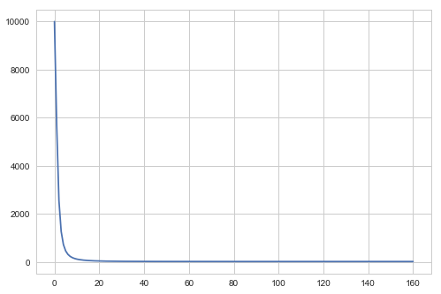
Static object (calf)
Image Object Velocity Estimation
Measured and filtered location (upper left corner)
Estimated velocity
Location variance
Velocity variance

Slide 7
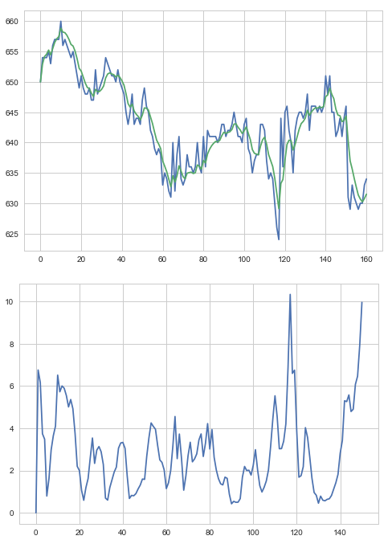
Static object (calf)
Image Object Velocity Estimation
10 step ahead mean prediction error

Slide 8
Software Architecture
Speech Synthesis
Video file
Camera
OpenCV
AnalyzeVideo
ObjectDetection
Speakers
ImageClasses
MobileNetSSD (caffe)
pyttsx3
SpeechSynthesis

Slide 9
Entities
Speech Synthesis
Image World
Image Object
Event
Event
text
priority
Event is generated when
new image object is created
image object status is changed
Event will pause the video for the duration of speech (not in the final version)
Events are collected (history)

Slide 10
Work in Progress

Slide 11
Perception
“The first step in achieving SA is to perceive the status, attributes, and dynamics of relevant elements in the environment. Thus, Level 1 SA, the most basic level of SA, involves the processes of monitoring, cue detection, and simple recognition, which lead to an awareness of multiple situational elements (objects, events, people, systems, environmental factors) and their current states (locations, conditions, modes, actions).”

Slide 12
Next Steps

Slide 13
Next steps
Comprehension:
Closing the open questions
2d -> 3d transformation
World object state estimation

Slide 14
To Be Discussed

Slide 15
Method follow-up
Google search enough?
Good way of following new papers?

Slide 16
Thank you!
lampola@student.tut.fi
https://github.com/SakariLampola/Thesis

